Slide 1
Teaching STEM
with Lego Education Systems
Search for … LEGO Mindstorms
Go to … Downloads
DL your platform… Mac, Windows, Android

Slide 2
Dragomanns
Education . Technology . Languages
Differentiated Learning Modules
From Preschool to 100+ year olds…
1. Lego
2. Technic / Bionical
3. Mindstorms - the EV3 is what we’ll be using
4. Tetrix

Slide 3
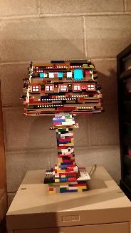
Dragomanns
Education . Technology . Languages
Introducing regular building blocks of Lego:
Its what you think of when you see the lamp to the right of you… Lego building systems of learning and play lay the foundation for creative thinking…
Technic and Bionical sets
introduce concepts of dynamic motion, gears, electronic automation, and various other moving parts and pieces for 5th-8th graders

Slide 4
Chances are… students don’t build or learn
with either of these systems:
Mindstorm: EV3 is a guide to robotic programming with various Technic pieces plus a programmable “intelligent brick.”
Tetrix: College level parts, pieces, and components that can be used for prototyping robotics and engineering designs.
The ideal age of exposure is middle school so that mechanical, electronic, engineering, and programming concepts are introduced collectively.
Notes:
Enthusiasts

Slide 5
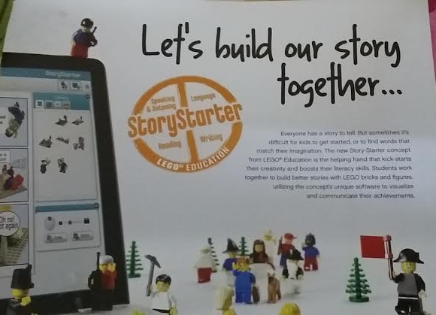
Lego Education
From KG through college, Lego offers hands on learning systems and curricula for STEM subjects:
Science Technology Engineering
Math
Notes:
Lego architecture, creating masterpieces of art with Lego

Slide 6
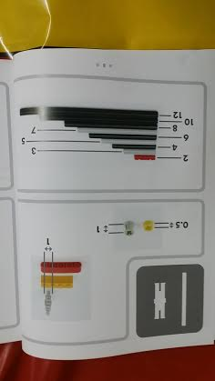
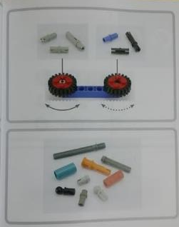
Measurement / Counting
Elementary school children are still learning to count, still learning to write and move their hands and fingers.
These pieces are great for teaching measurement, counting, arithmetic, and space – visualization.
Pre-schoolers use ‘Duplo’ sets that are big…
Notes:
Learning the transitive and distributive properties of multiplication with a flat lego board

Slide 7
Gears & Motion
Transfer of power can be a difficult concept to grasp in middle and high school. Hands on building accomplishes this in ONE learning session.

Slide 8
Rotations &
Revolutions
Wheels and gears are great for circle geometry:
circumference, pi, the radius, radian measures, diameter…

Slide 9
Force , Torque , & Renewables
There are Green Energy science kits that allow students to build and test windmills and solar power…
Concepts in physics include force, speed, velocity, distance, and electromagnetics even…
Simple designs and constructions can teach the power of gears, pulleys and levers…

Slide 10
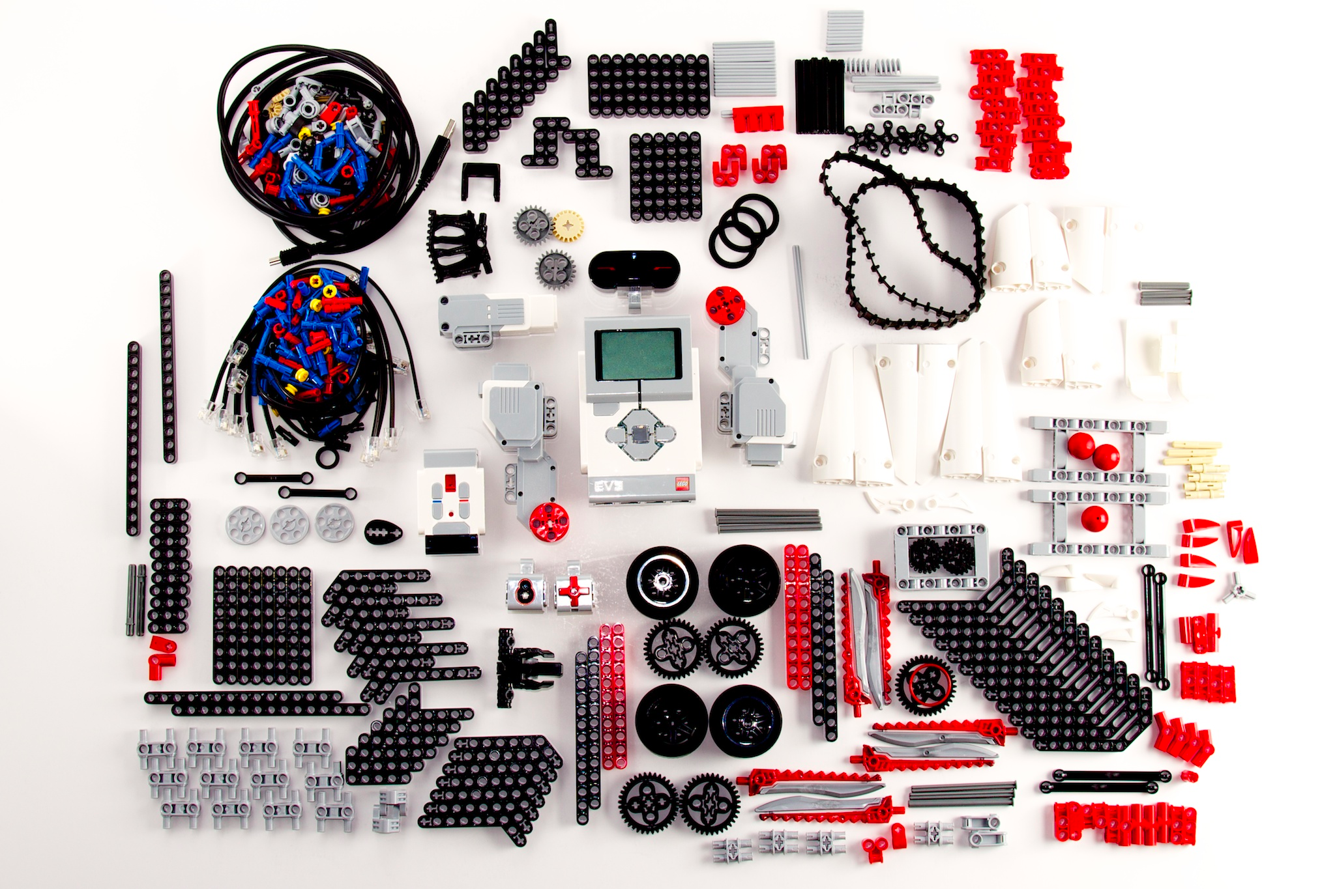
EV3 Robotics Set
For hands on immersion experience in STEM and robotics, the EV3 is an ideal system.
Dragomanns offers:
2-day
1 week
1 month
workshop programs.

Slide 11
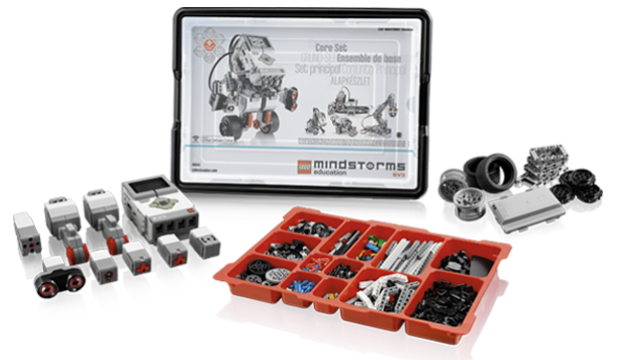
EV3 Education Set

Slide 12
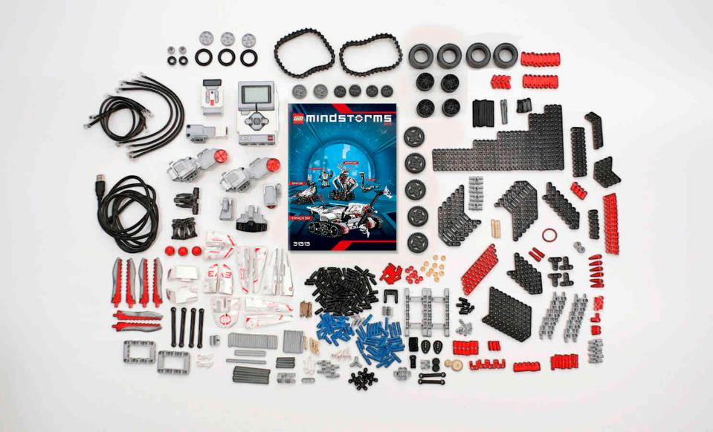
The EV3 retail set is available in the market for purchase, and also through Dragomanns…

Slide 13
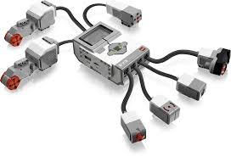
Intelligent Brick
Sensors are inputs that provide data to the intelligent brick.
Motors are outputs that move according to some program or code written by students.

Slide 14
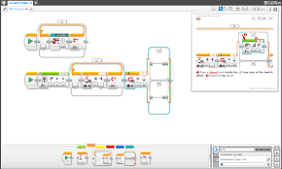
Programming Interface

Slide 15
Programming block colors
Action Blocks
Flow Blocks
Sensor Blocks
Data Operations
Advanced
Personalized

Slide 16
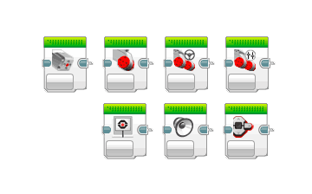
Action Bricks

Slide 17
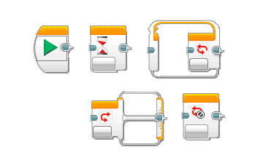
Flow Control blocks

Slide 18
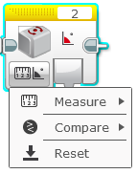
Sensor blocks

Slide 19
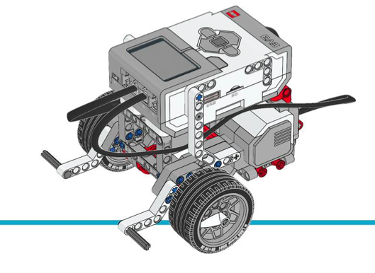
Our workshop Mission :
Build the basic educator robot.
Use & program 1 sensor & motor.

Slide 20
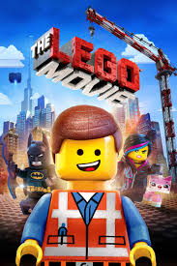
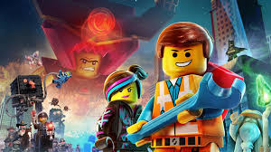
The Lego Movie
The word Lego was coined with an amalgam of ‘play’ and ‘good.’ It is important to have fun while learning.

